Slide 1




Slide 2
Agenda
Day in the life of…
Three Skills
Collaboration
Software Patterns
Software Testing
Open Forum

Slide 3
Who am I?

Slide 4
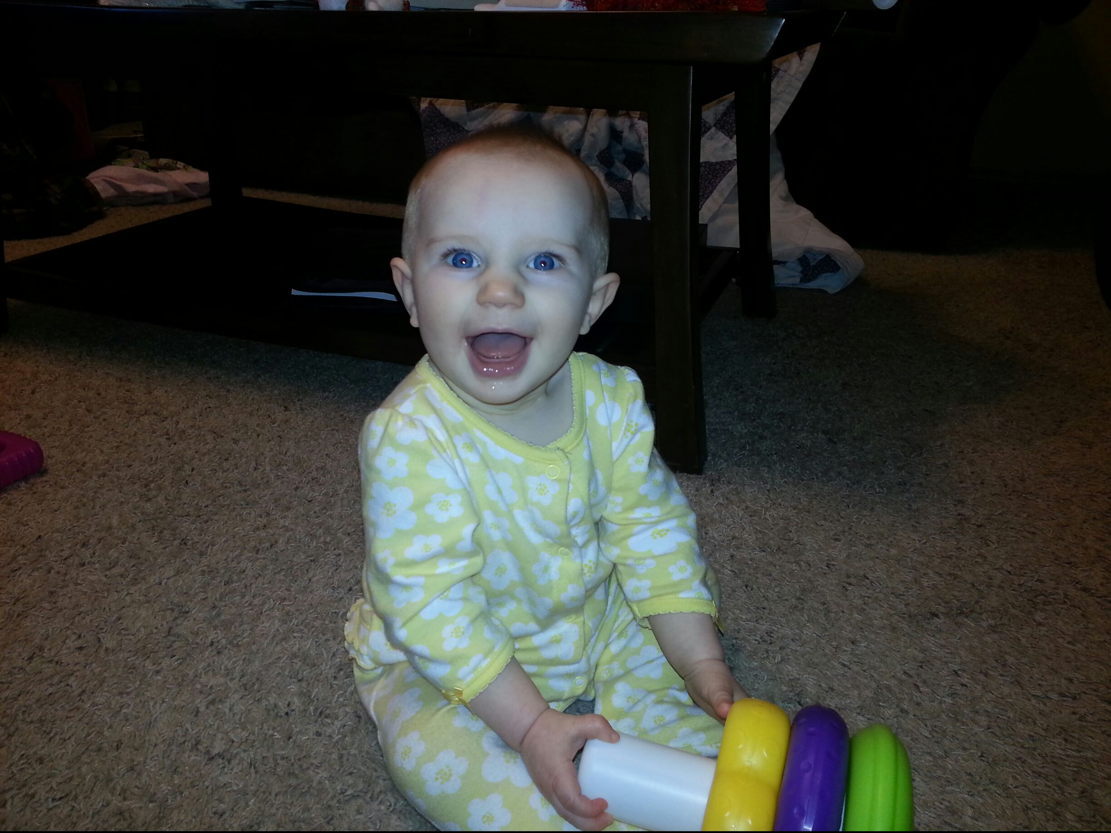
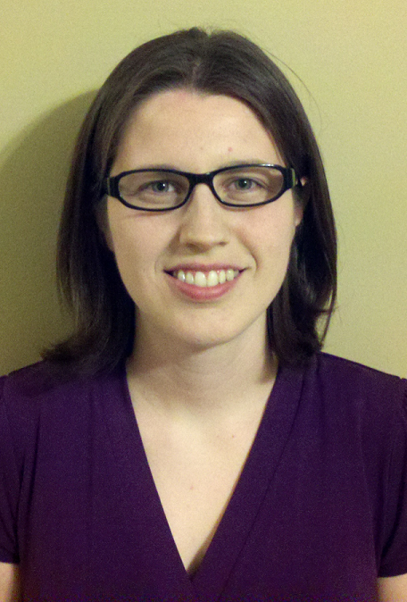
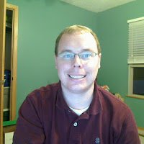
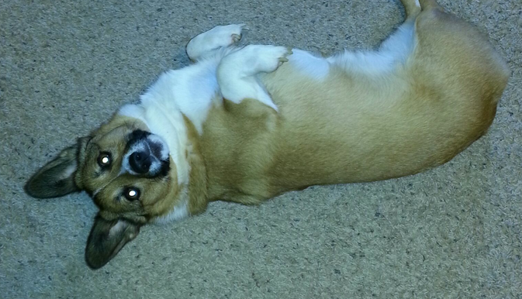

Slide 5
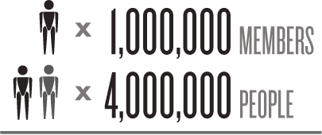
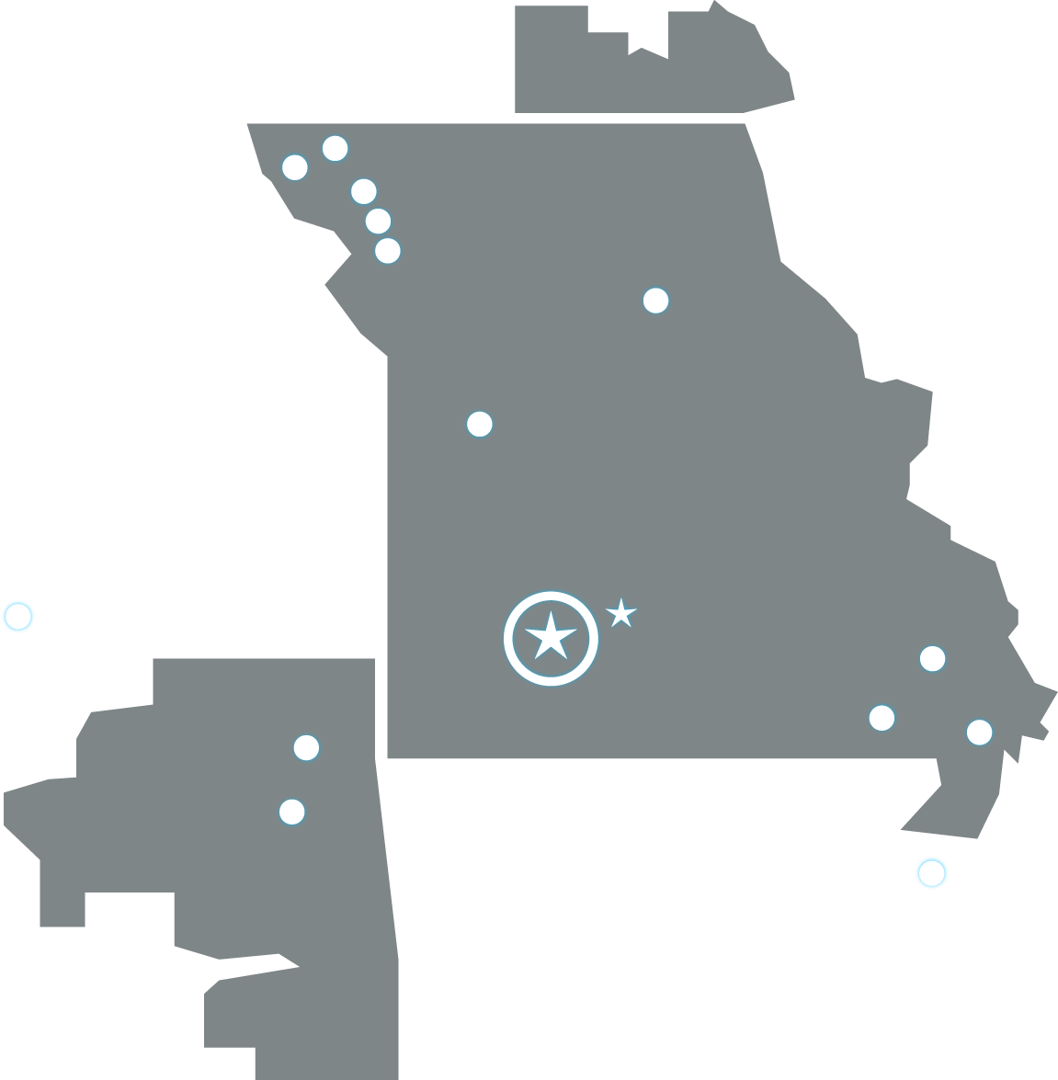
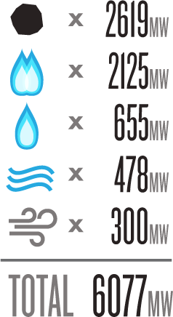
Notes:
Associated Electric
Based in Springfield Missouri [click to annimate], serving one million members or 4 million people in Missouri, Southern Iowa and North Eastern Oklahoma
Own or Operate 2 Coal Fire Generating Stations, 3 Combined Cycle natural gas Plants, 4 simple cycle gas/oil plants.
Hydro Electric power from SPA, 5 wind farms

Slide 6
Imagine that you are an entry level software developer
Based on a true story of an actual intern and CIS student from Missouri State

Slide 7




Happy Managers!
“Outage” = Grumpy Managers

Slide 8
Import all outage records into SharePoint as they happen at our Power Plants
Read from outage system of record
Write data to SharePoint
Record the record in a database

Slide 9

Monday
Tuesday
Wednesday
Thursday
Friday
Planning/Updating
Projects / Support
O3’s/BPRM
Projects / Support
Local Planning/Learning
Early Morning
6:00 - 9:00
[2W] O3s 8:00-3:00
[3W] Tech Faire 8:00-10:00
[1W] Team Standups 8:30-9:30
[1W] Team Standups 8:30-9:30
[1W] Team Standups 8:30-9:30
[1W] Team Standups 8:30-9:30
[1W] Team Standups 8:30-9:30
[4W] Dept Meeting
9:30-10:30
[3W] Feedback 10:00-10:30
Late Morning
9:00 - 11:30
[1W/2W]
Chartered Team Meetings
/Project Meetings
/Ad-Hoc Meetings
9:00-3:00
[4W] Division Meetings
10:30-11:30
Lunch
11:30 - 1:00
[1W] Team Tacticals
1:15-2:00
Early Afternoon
1:00 - 3:00
Late Afternoon
3:00 - 6:00

Slide 10
Monday
Tuesday
Wednesday
Thursday
Friday
Planning/Updating
Projects / Support
O3’s/BPRM
Projects / Support
Local Planning/Learning
Early Morning
6:00 - 9:00
[2W] O3s 8:00-3:00
[3W] Tech Faire 8:00-10:00
[1W] Team Standups 8:30-9:30
[1W] Team Standups 8:30-9:30
[1W] Team Standups 8:30-9:30
[1W] Team Standups 8:30-9:30
[1W] Team Standups 8:30-9:30
[4W] Dept Meeting
9:30-10:30
[3W] Feedback 10:00-10:30
Late Morning
9:00 - 11:30
[1W/2W]
Chartered Team Meetings
/Project Meetings
/Ad-Hoc Meetings
9:00-3:00
[4W] Division Meetings
10:30-11:30
Lunch
11:30 - 1:00
[1W] Team Tacticals
1:15-2:00
Early Afternoon
1:00 - 3:00
Late Afternoon
3:00 - 6:00

Slide 11
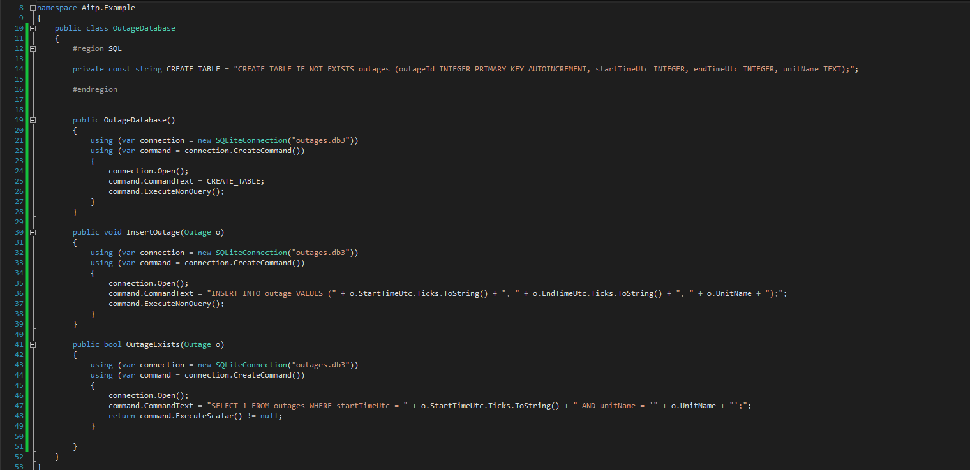

Slide 12
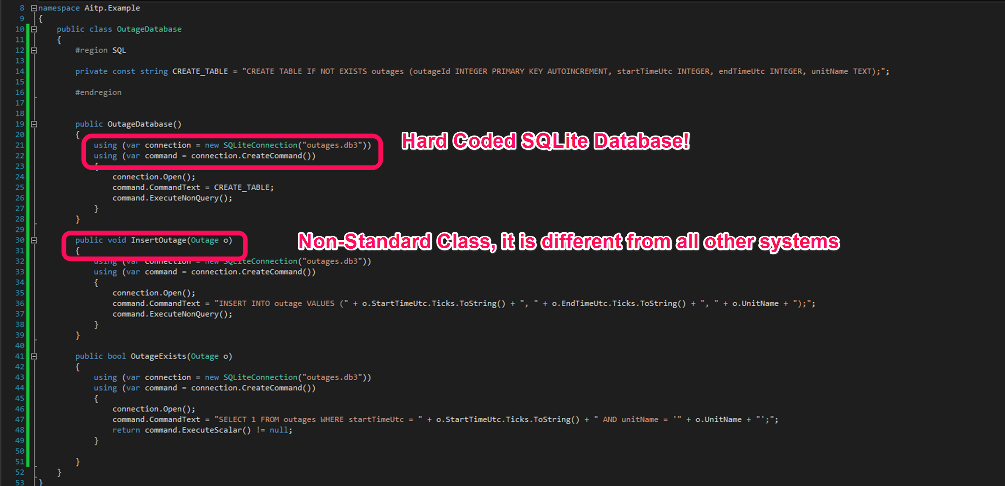

Slide 13
Software Patterns
Why is your stuff different from mine?

Slide 14
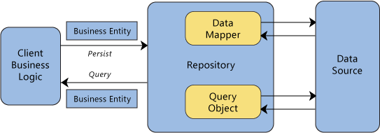
Repository Pattern
Notes:
https://msdn.microsoft.com/en-us/library/ff649690.aspx

Slide 15



Inversion of Control/Dependency Injection
Hey Repository, I need you
SQL Server
“Factory”
Repository
Your Program
Your “Repository”
Hey Factory, I need an Outage Repository!
I need a database first
Notes:
https://msdn.microsoft.com/en-us/magazine/cc163739.aspx

Slide 16
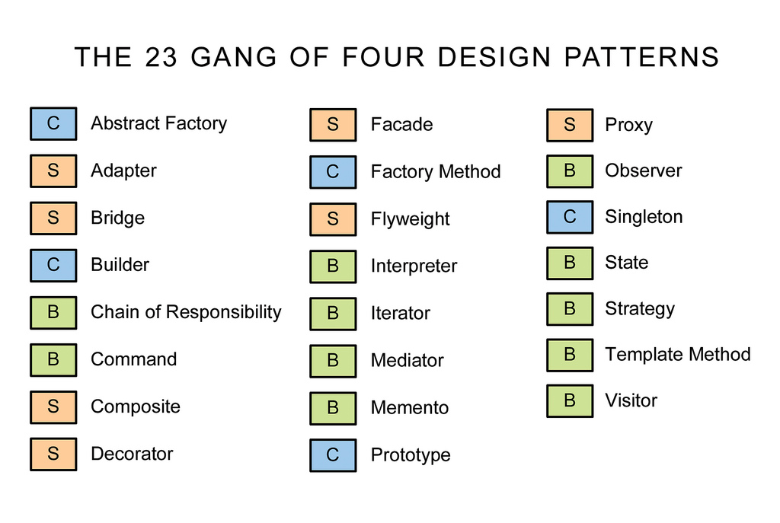

Notes:
Some of the most commonly used patterns come from a group known as the “Gang of Four” if you are interested here is there book.

Slide 17
Suggested Reading
Design Patterns (Amazon.com)
Repository Pattern (https://msdn.microsoft.com/en-us/library/ff649690.aspx)
Dependency Injection (https://msdn.microsoft.com/en-us/magazine/cc163739.aspx)

Slide 18
Monday
Tuesday
Wednesday
Thursday
Friday
Planning/Updating
Projects / Support
O3’s/BPRM
Projects / Support
Local Planning/Learning
Early Morning
6:00 - 9:00
[2W] O3s 8:00-3:00
[3W] Tech Faire 8:00-10:00
[1W] Team Standups 8:30-9:30
[1W] Team Standups 8:30-9:30
[1W] Team Standups 8:30-9:30
[1W] Team Standups 8:30-9:30
[1W] Team Standups 8:30-9:30
[4W] Dept Meeting
9:30-10:30
[3W] Feedback 10:00-10:30
Late Morning
9:00 - 11:30
[1W/2W]
Chartered Team Meetings
/Project Meetings
/Ad-Hoc Meetings
9:00-3:00
[4W] Division Meetings
10:30-11:30
Lunch
11:30 - 1:00
[1W] Team Tacticals
1:15-2:00
Early Afternoon
1:00 - 3:00
Late Afternoon
3:00 - 6:00

Slide 19
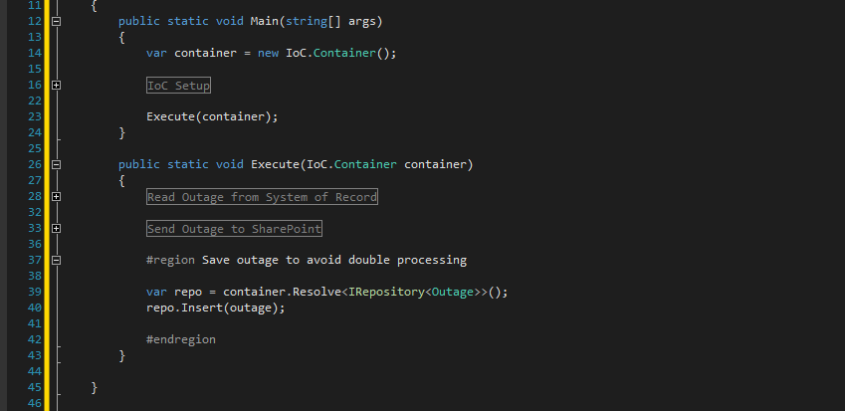
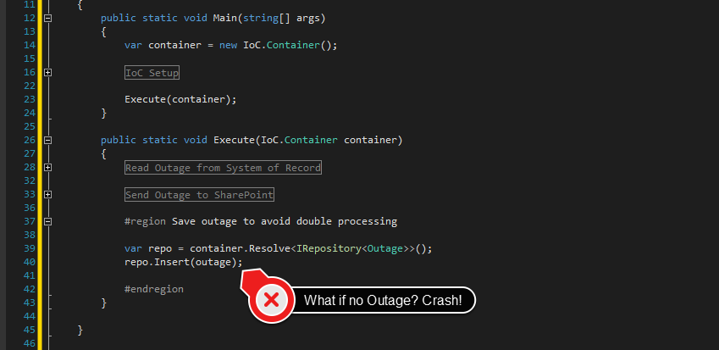

Slide 20
Unit Testing
So prove to me your stuff works
Notes:
https://msdn.microsoft.com/en-us/library/hh598960.aspx

Slide 21
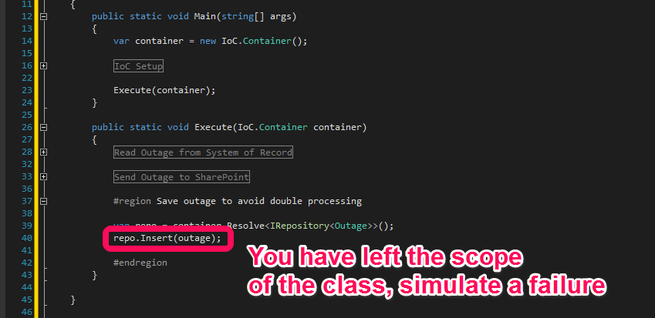

Slide 22
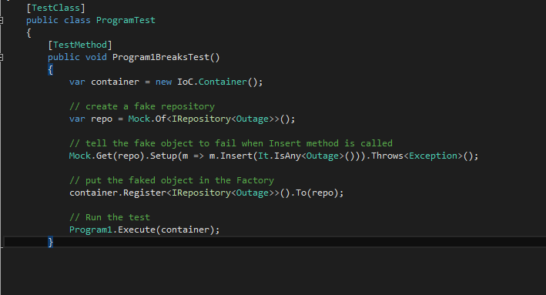

Slide 23
Suggested Reading
MSDN (https://msdn.microsoft.com/en-us/library/hh598960.aspx)
http://en.wikipedia.org/wiki/List_of_unit_testing_frameworks
There is no right way to unit test, practice is the best way to learn this skill

Slide 24
Monday
Tuesday
Wednesday
Thursday
Friday
Planning/Updating
Projects / Support
O3’s/BPRM
Projects / Support
Local Planning/Learning
Early Morning
6:00 - 9:00
[2W] O3s 8:00-3:00
[3W] Tech Faire 8:00-10:00
[1W] Team Standups 8:30-9:30
[1W] Team Standups 8:30-9:30
[1W] Team Standups 8:30-9:30
[1W] Team Standups 8:30-9:30
[1W] Team Standups 8:30-9:30
[4W] Dept Meeting
9:30-10:30
[3W] Feedback 10:00-10:30
Late Morning
9:00 - 11:30
[1W/2W]
Chartered Team Meetings
/Project Meetings
/Ad-Hoc Meetings
9:00-3:00
[4W] Division Meetings
10:30-11:30
Lunch
11:30 - 1:00
[1W] Team Tacticals
1:15-2:00
Early Afternoon
1:00 - 3:00
Late Afternoon
3:00 - 6:00

Slide 25
Summary
Intern create a small system in 2011
Utilized daily standups to collaborate will colleagues
Learned Software Patterns used by the team
Used Unit Testing to simulate failures in the program
This program was used by Sr. Managers for 3 Years with zero issues
Intern create a small system in 2011
Utilized daily standups to collaborate will colleagues
Learned Software Patterns used by the team
Used Unit Testing to simulate failures in the program
This program was used by Sr. Managers for 3 Years with zero issues

